Slide 1

Socio-Technical Innovation Bundles for Agri-Food Systems Transformation
Christopher B. Barrett
Dyson/Econ/GD/Public Policy
Cornell University
Rose Scholars Program (UNILWYL 1402)
Cornell University
September 15, 2021

Slide 2







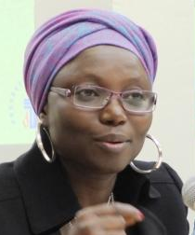




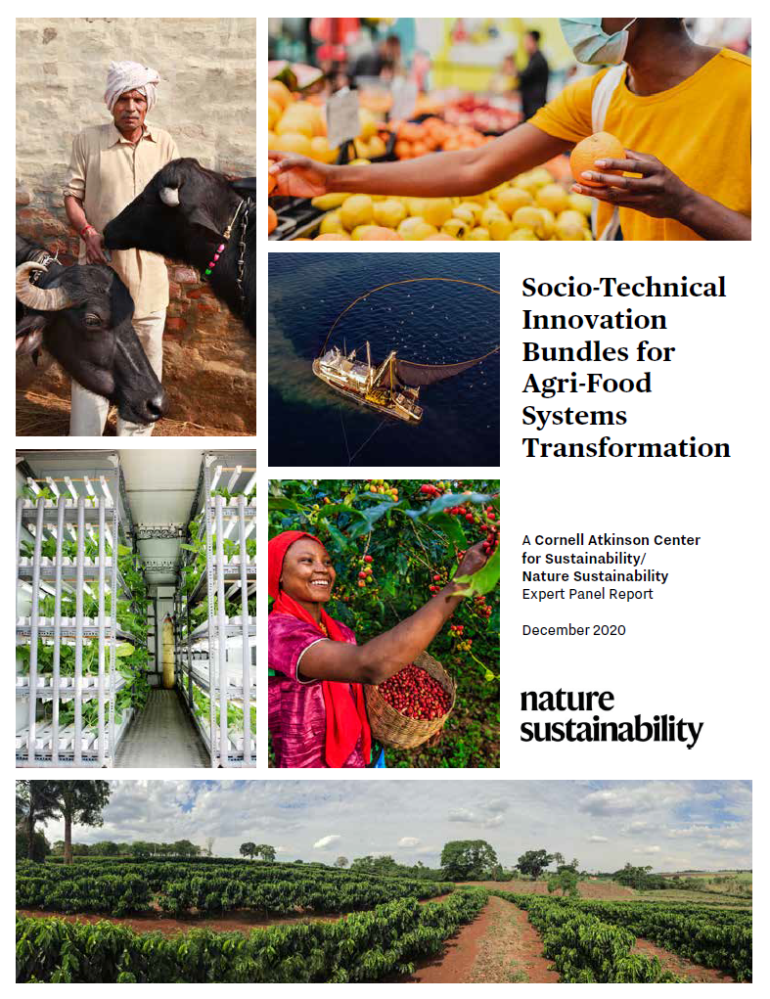











Expert panel
Cornell Atkinson – Nature Sustainability 2020 expert panel on “Innovations to Build Sustainable, Equitable, Inclusive Food Value Chains,” a diverse group of 23 experts from across disciplines, regions, organizations, etc., w/10 additional co-authors.
Report issued Dec. 2020 on Nature web site. Open access book in Palgrave Macmillan SDG series soon.
Based on the”, released Dec. 2020.

Slide 3
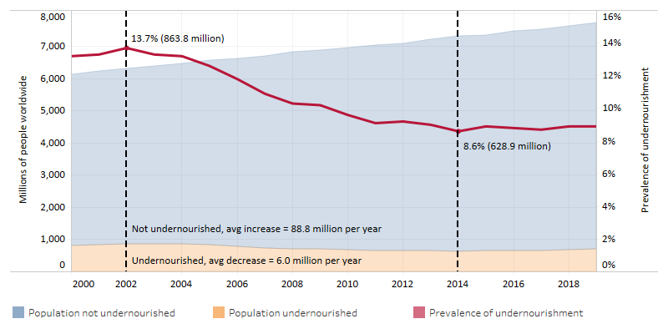
Core motivation
We must hold two fundamental truths firmly in mind:
(1) 1960s/70s objectives – grow supply of staple cereals to avert famine – sparked AFS innovations that enabled huge advances in human well-being.
(2) Those innovations also had major, adverse, unsustainable spillover effects on climate, natural environment, public health/nutrition, social justice.
We must update objectives, accelerate/reorient innovations for 21st century.

Slide 4
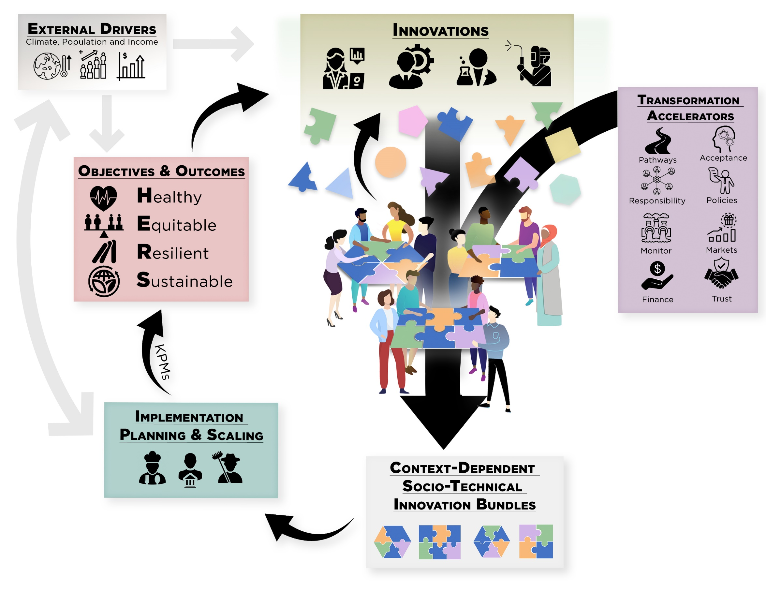
Key conclusions
Build around a shared vision of HERS agri-food systems.
Must embrace multiple objectives simultaneously:

Slide 5
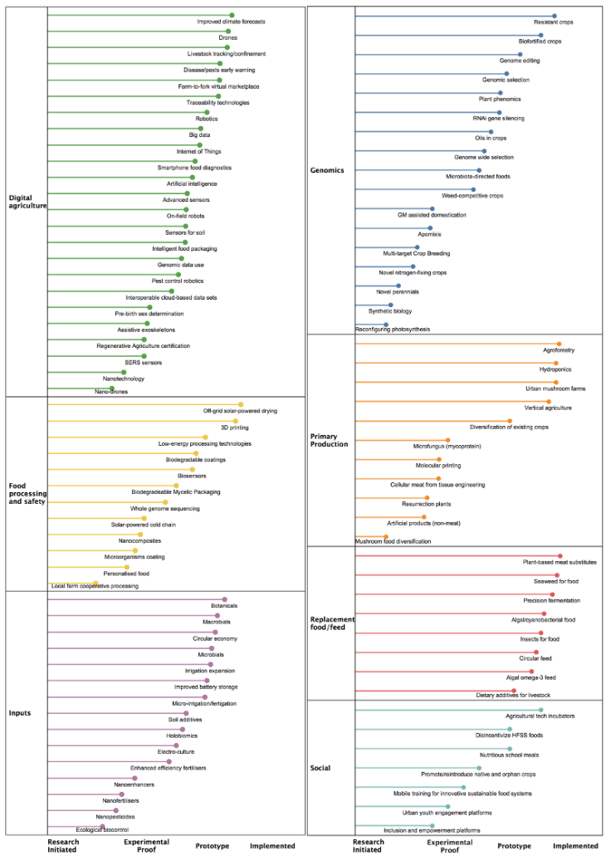
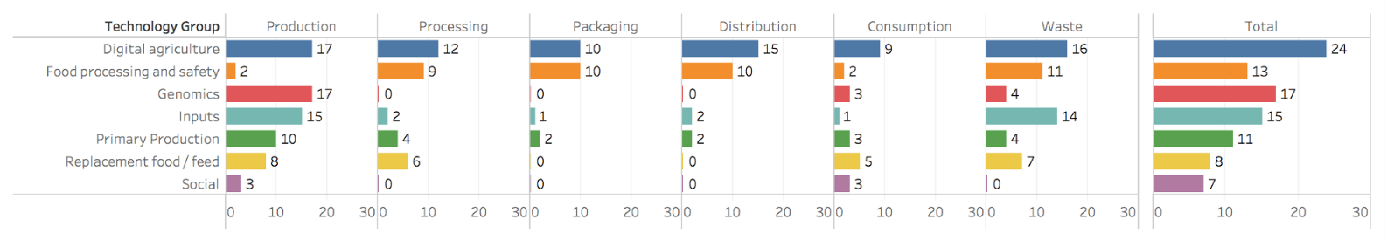
Key conclusions
A profuse pipeline exists of promising (natural and social) science advances at various stages of deployment readiness. Span value chains and geographies.

Slide 6
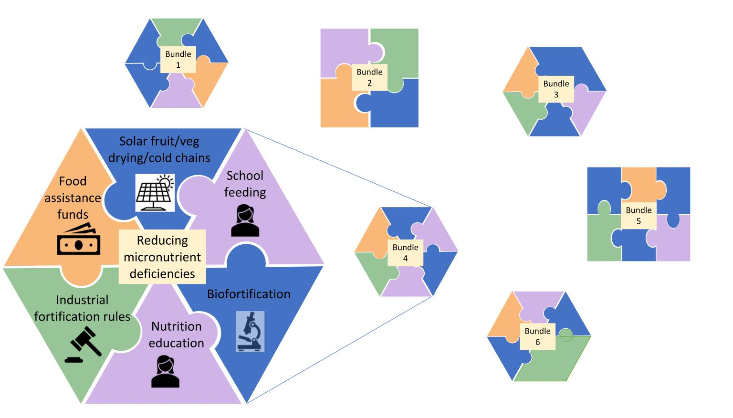
7 Essential Actions
Develop socio-technical innovation bundles
Why bundle?
  No magic bullets exist. Multiple constraints; relaxing just one limits progress. Must realize synergies to adapt/scale.
  Must address political economy of spillovers and creative destruction. Coalitions from bundling can overcome incumbent status quo bias
  Heterogeneous needs require bundled solutions

Slide 7

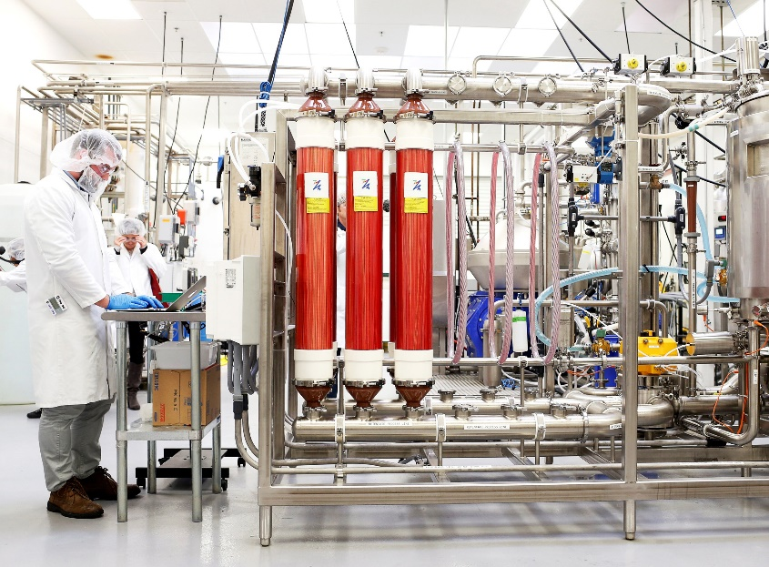
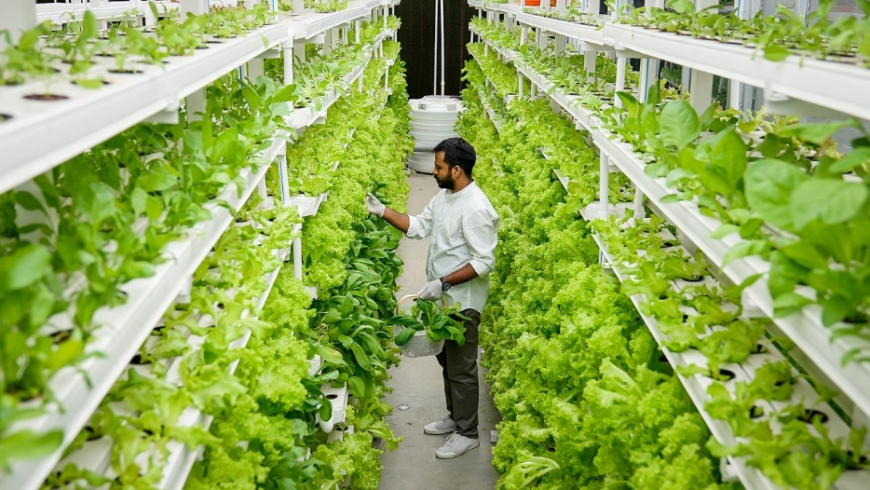
7 Essential Actions
2. Reduce the land and water footprint of food
Decoupling food production from land increasingly culturally, economically, technologically feasible. Must manage de-agrarianization’s creative destruction.
Photo: Beck Deifenbach/Reuters
Photo: Gerry Machen/Creative Commons
Photo: Betterindia.com

Slide 8
7 Essential Actions
3. Reconfigure public support for AFSs
Two key roles for gov’ts:
1. invest in essential public goods and services: e.g., NSF-funded research
2. facilitate dialogue to find cooperative solutions
Much current government AFS spending is wasteful ($2bn/day!)
Redirect towards social protection programs, agri-food research, and physical and institutional infrastructure.
Foster civil society dialogues to identify and support contextually appropriate socio-technical bundles.

Slide 9
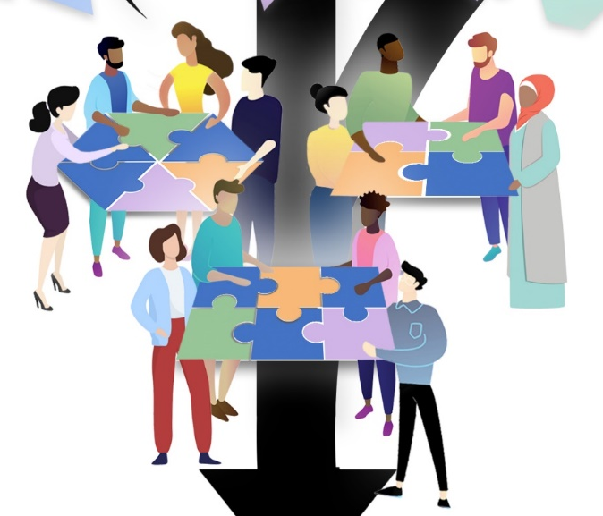
7 Essential Actions
4. Commit to co-creation with shared and verifiable responsibility Agreed KPMs, safety nets, penalties can accelerate beneficial innovation and minimize adverse unintended consequences.

Slide 10
7 Essential Actions
5. Deconcentrate power
Reducing market and political power imbalances and broadening participation in innovation dialogues can accelerate innovation.

Slide 11
7 Essential Actions
6. Mainstream systemic risk management
COVID-19 underscores the rising importance of effective systemic risk management. Need innovative risk reduction and risk transfer mechanisms.

Slide 12
7 Essential Actions
7. Develop novel financing mechanisms
AFS innovations require $$$ (hundreds of billions annually).
How to mobilize private resources beyond public spending/philanthropy?

Slide 13
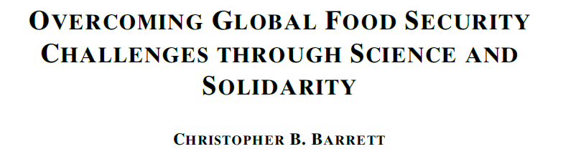
Thank you
Report and associated journal articles, videos, etc. available at https://blogs.cornell.edu/nature-sustainability/
Thank you for your time and interest!
COVID-19 Pandemic Lessons for Agri-food Systems Innovation
Environmental Research Letters, forthcoming

